Slide 1
What is Software Development?
Software Development is the process of designing, building, testing, and maintaining software applications or systems that run on computers, mobile devices, or the web.
Type of Software Development
Web Development
Mobile App Development
Desktop Application Development
Game Development

Slide 2
Web Development
Web development is all about building websites or web apps that you can open in a browser — like Chrome, Safari, or Firefox). Examples of web applications are YouTube, Facebook, Instagram, etc.
Web Development is made of:
Frontend Development – what users see and interact with on their browser.
Backend Development – what happens behind the scenes.
Database – where data is stored and retrieved.

Slide 3
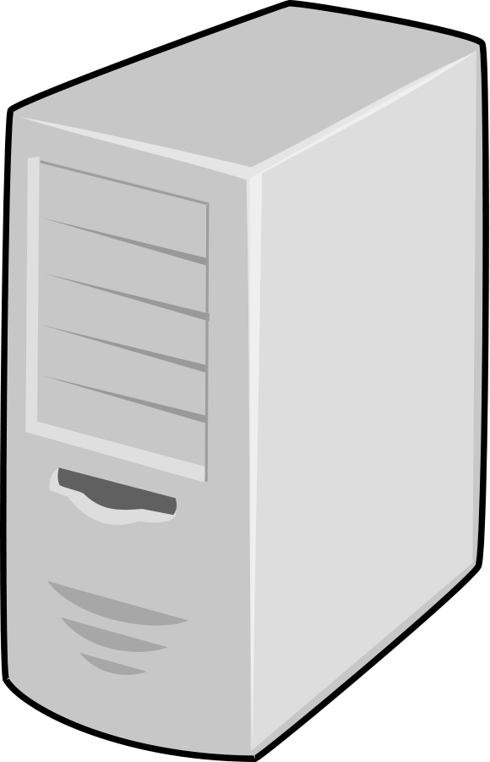
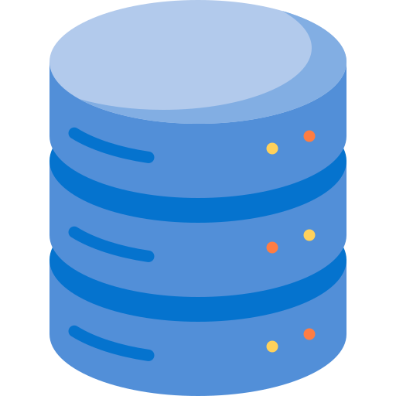
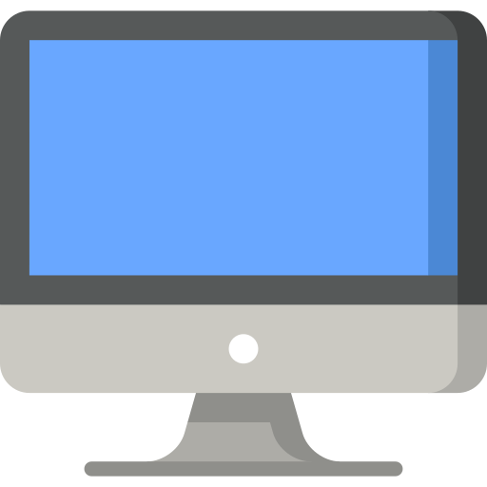
Web Development
Server (Backend)
Database (Data)
Client (Frontend)
Simplified Request-Response View

Slide 4
What is it all about?
Web apps are all about communication and transfer of data between computers (client, server, database).
Computers interacts with each other via Networks.
Networks uses protocols (standard agreements) – IP addresses and ports.
IP addresses and ports are like human physical home addresses and house numbers. Example of IP address is 157.240.229.35, port is 5000

Slide 5
What is it all about?
Web apps are all about communication and transfer of data between computers (client, server, database).
Computers interacts with each other via Networks.
Networks uses protocols (standard agreements) – IP addresses and ports.
IP addresses and ports are like human physical home addresses and house numbers.

Slide 6
Phase 1
You type www.facebook.com into your browser.
www.facebook.com
Browser
Client (Frontend)

Slide 7
DNS Server
www.facebook.com
Request 1
Phase 2
Your browser sends it to DNS server to get the IP address for that domain.
www.facebook.com
Browser
Client (Frontend)

Slide 8
DNS Server
157.240.241.35
Response 1
www.facebook.com
Request 1
Phase 3
The DNS server responds with the IP address.
www.facebook.com
Browser
Client (Frontend)

Slide 9
Frontend Server
DNS Server
157.240.241.35
Response 1
157.240.241.35
www.facebook.com
Request 2
Request 1
Phase 4
With the IP address, your browser sends a request to the Frontend server to fetch Facebook frontend files.
www.facebook.com
Browser
Client (Frontend)

Slide 10

Frontend Server
DNS Server
157.240.241.35
Response 1
157.240.241.35
www.facebook.com
HTML
CSS
Request 2
Request 1
JavaScript
Phase 5
Response 2
The Frontend server responds with the frontend files.
Your browser display these files.
You can now interact with these frontend files on your browser.
HTML
CSS
JavaScript
Browser
Client (Frontend)

Slide 11


Frontend Server
DNS Server
Phase 6
To login to Facebook, you type your email and password.
Your browser sends the data to Facebook backend server (e.g. www.facebook.com/api) – the domain is already resolved to its IP address.
157.240.241.35
Response 1
157.240.241.35
www.facebook.com
HTML
CSS
Request 2
Request 1
JavaScript
Code
Response 2
HTML
CSS
JavaScript
Browser
Email
Client (Frontend)
Password
Server (Backend)
Request 3

Slide 12
Frontend Server
DNS Server
Phase 7
The backend server processes the request.
It sends a request to the database to get the information on your profile.
157.240.241.35
Response 1
157.240.241.35
www.facebook.com
HTML
CSS
Request 2
Request 1
JavaScript
Code
Response 2
HTML
CSS
JavaScript
Browser
Email
Email
Client (Frontend)
Password
Password
Database (Data)
Server (Backend)
Request 3
Request 4

Slide 13
Frontend Server
DNS Server
Phase 8
The database responds to the server with your name, pictures, friends list, etc.
157.240.241.35
Response 1
157.240.241.35
www.facebook.com
HTML
CSS
Request 2
Request 1
JavaScript
Code
Name
Response 2
Pictures
Friends List
HTML
CSS
JavaScript
Response 4
Browser
Email
Email
Client (Frontend)
Password
Password
Database (Data)
Server (Backend)
Request 3
Request 4

Slide 14
Frontend Server
DNS Server
Phase 9
The server returns your data to the browser.
The browser displays profile as received.
157.240.241.35
Response 1
157.240.241.35
www.facebook.com
HTML
CSS
Request 2
Request 1
JavaScript
Code
Name
Name
Response 2
Pictures
Pictures
Friends List
Friends List
HTML
CSS
JavaScript
Response 4
Response 3
Browser
Email
Email
Client (Frontend)
Password
Password
Database (Data)
Server (Backend)
Request 3
Request 4

Slide 15
Frontend Server
DNS Server
157.240.241.35
Response 1
157.240.241.35
www.facebook.com
Backend Development
HTML
CSS
Request 2
Request 1
JavaScript
Code
Name
Name
Response 2
Pictures
Pictures
Friends List
Friends List
HTML
CSS
JavaScript
Response 4
Response 3
Browser
Email
Email
Client (Frontend)
Password
Password
Database (Data)
Server (Backend)
Request 3
Request 4

Slide 16
What is Backend Development?
Backend Development is the part of web or software development that focuses on the server side — the logic, database interactions, APIs, authentication, and overall system architecture that power what users see and do on the frontend (the user interface).
Backend Development comprises of the following:
Written code or the application (e.g., NodeJS, Java , Python, etc.).
Server – where the application runs.
Business logic – the core rules and operations implemented in the written code that makes the application work.
Database – where data is stored and managed (e.g., MySQL, MongoDB, PostgreSQL).
APIs (Application Programming Interfaces) — the middle layer that connects the frontend to the backend.
Security & Authentication — controlling who can access what (e.g., JWT, OAuth).

Slide 17
Backend Development Overlaps?
Desktop Development
Web Development
Backend Development
Mobile Development
Mobile Development

Slide 18
Software Tools
NodeJS - Runtime Environment
VS Code - Code Editor
MySQL Server and Workbench - Database Server.
Docker - Containerization Software.
Git (and register GitHub account) - Version Control
Postman – REST HTTP Client

